Slide 1
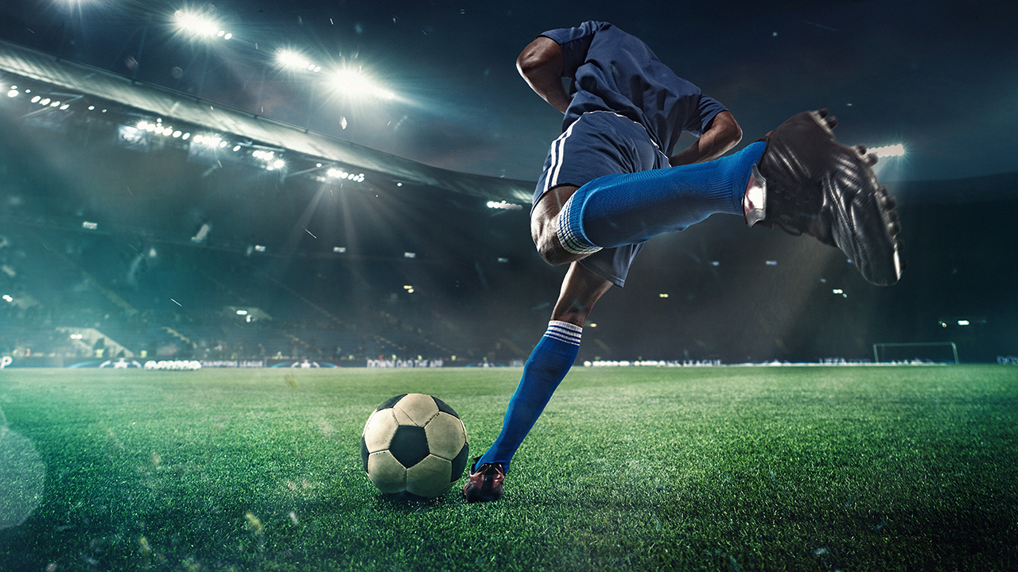
DATA MODEL PROPOSAL- ENCHANCING GAME EXPERIENCE FOR TORONTO FC
Welcome! We're excited to explore Toronto FC fan behavior to help improve the fan experience.

Slide 2
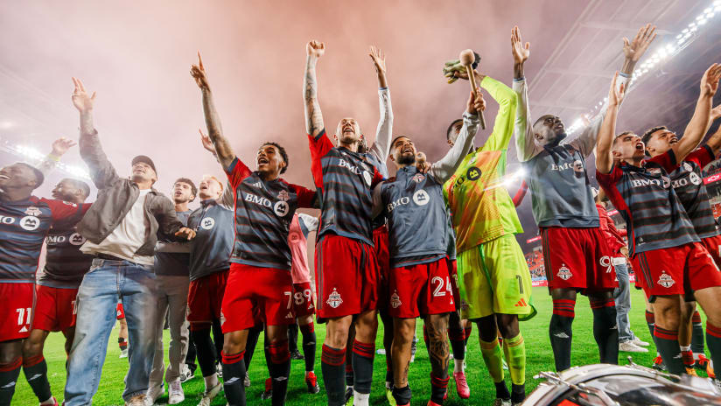
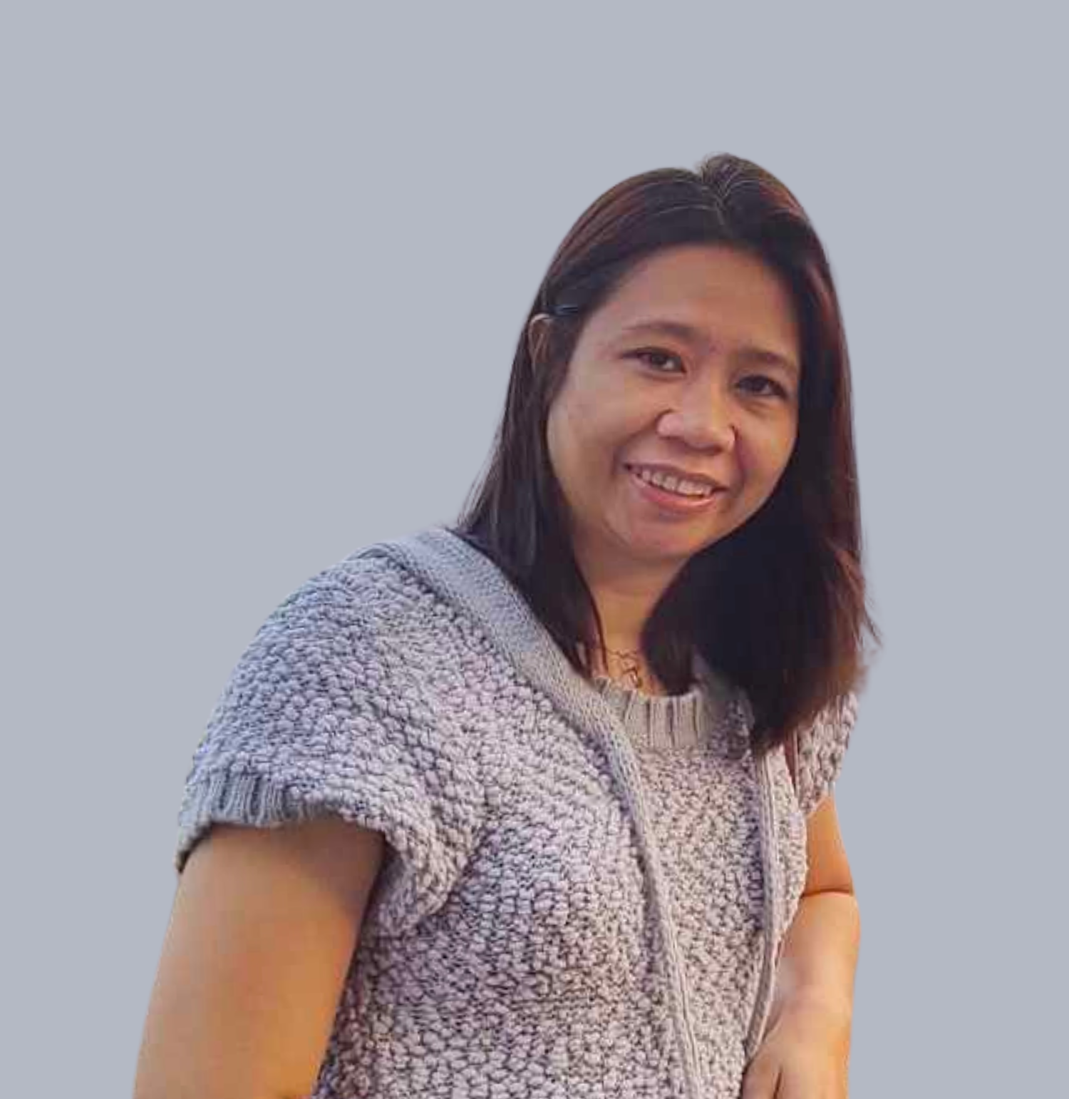

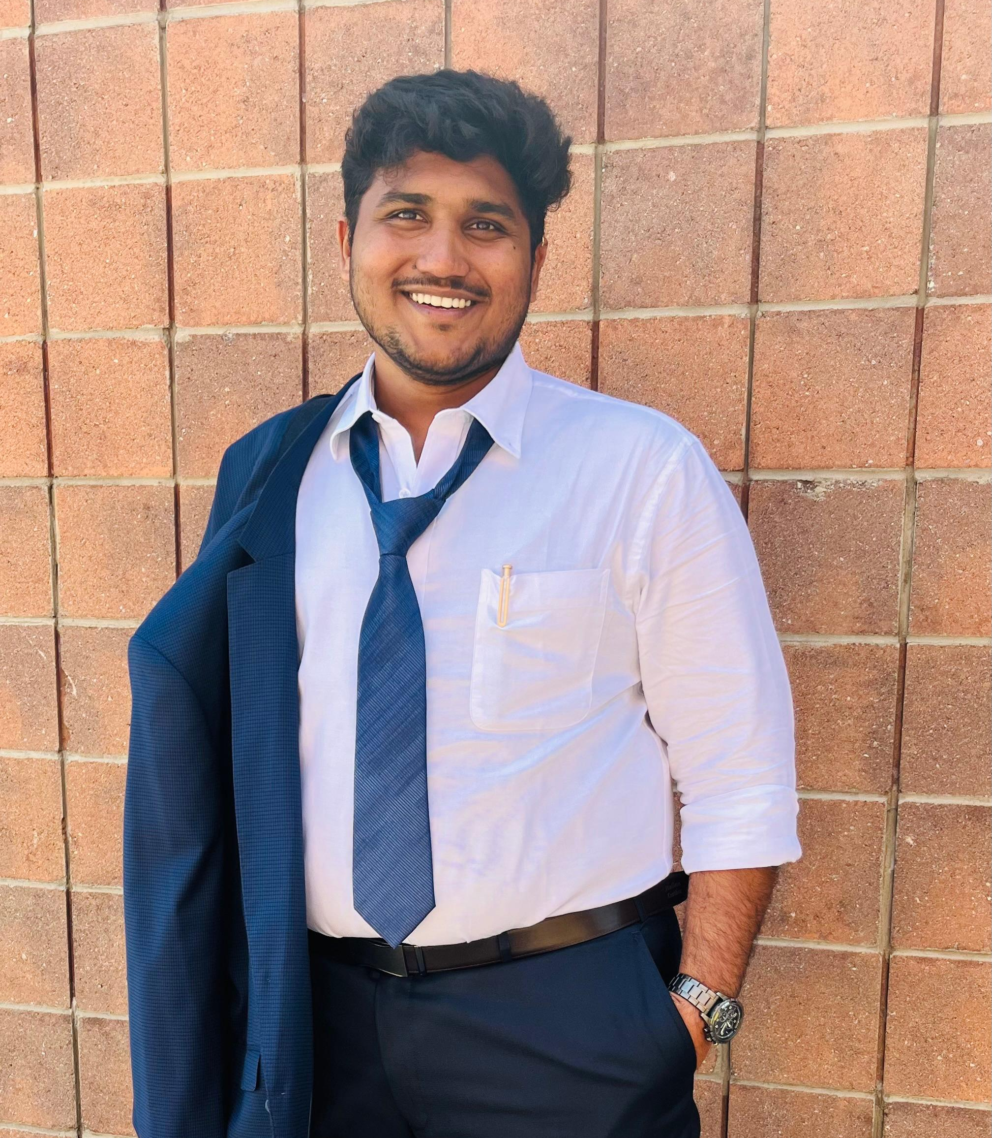
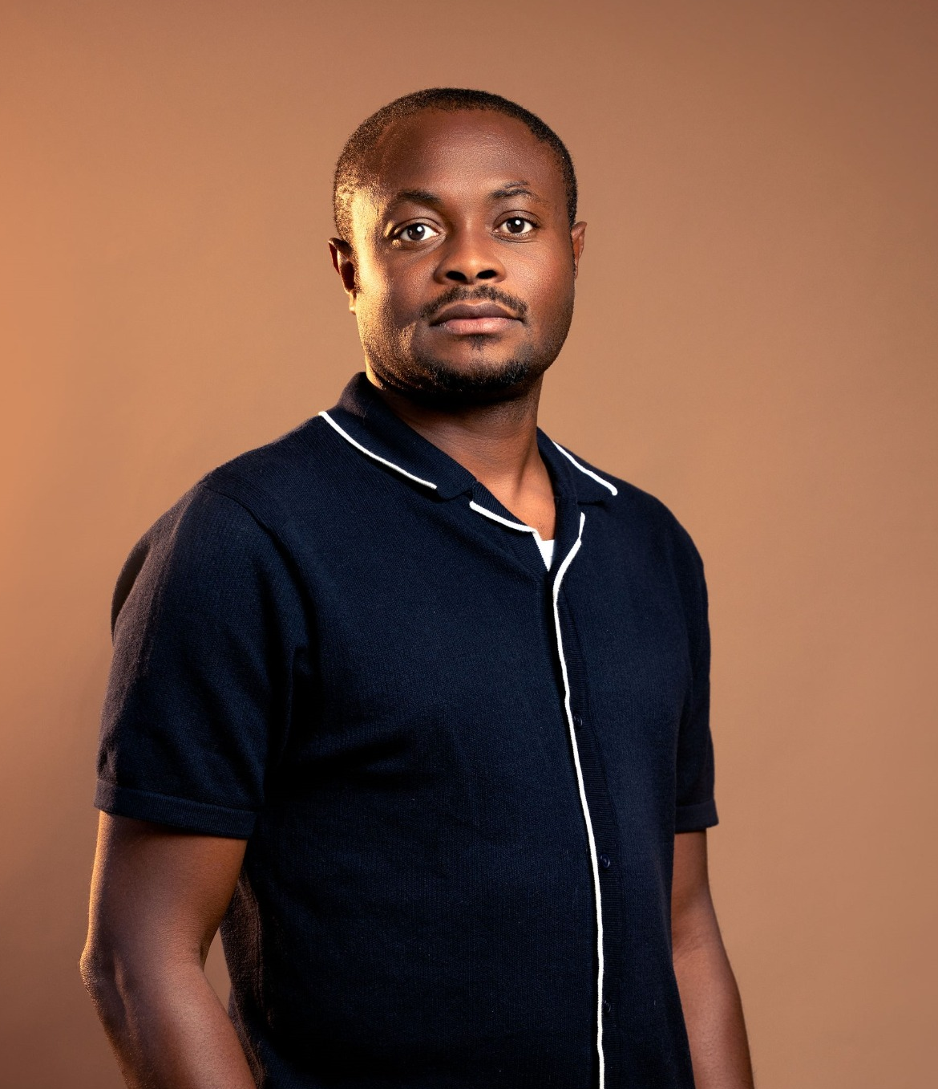

TEAM MEMBERS
Prescila Mora
Mohamed Afthab
Venkata Manish
Chibuike Okoroama

Slide 3
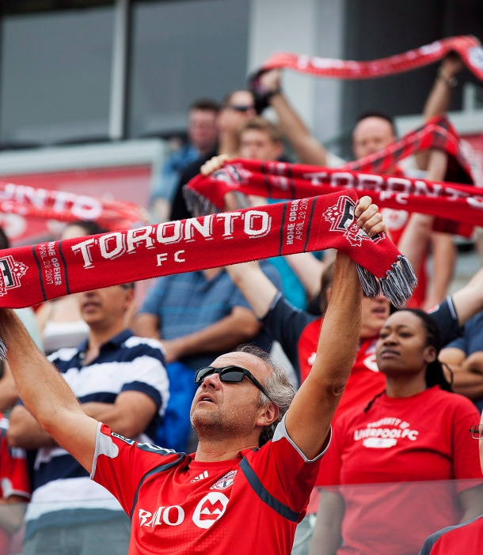
CLIENT
Name : Toronto FC (Football Club)
Location : Bay St. Toronto, Ontario
Phone : (416) - 360 - 4625
Team Worth : $ 690 M
Fan Base : Red Boys
Home Stadium : BMO Field, Toronto
Stadium Capacity : 30000+
League : Major League Soccer

Slide 4
AGENDA
Recap
Objective
Data Sources
Data Structure
Sarah’s Game Day Experience
References

Slide 5
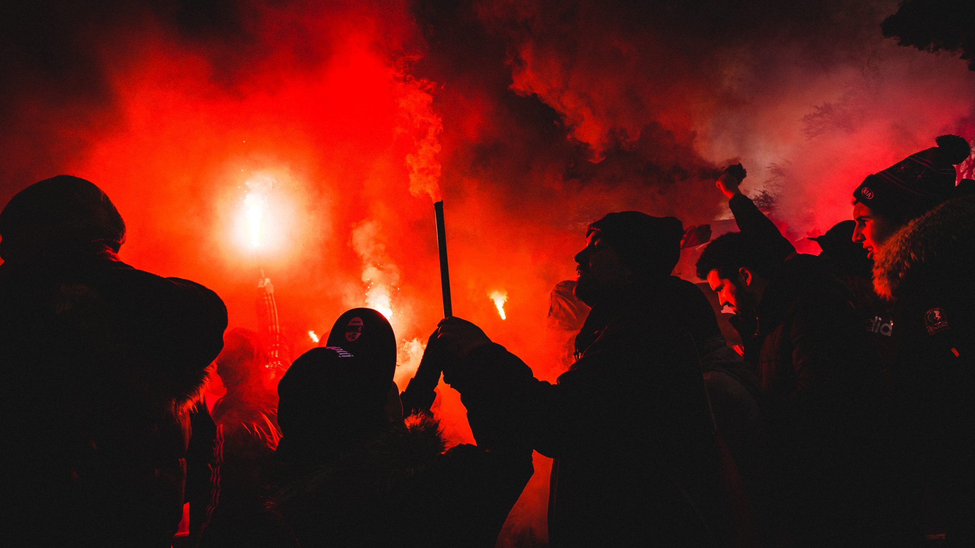
RECAP
Objective: Conduct a feasibility analysis on correlating weather data with Toronto FC's fan attendance to reward loyalty.
Key Focus:
Analyze data from 2014-2024 home games.
Design an algorithm to enhance fan engagement and optimize marketing strategies.
Advantages:
Tailored Promotions: Utilize weather forecasts to boost attendance.
Increased Loyalty: Strengthen emotional connection with fans.
Innovative Marketing: Create a unique, data-driven approach in sports marketing.
Conclusion: The algorithm is practical and valuable for increasing fan engagement and attendance.

Slide 6
OBJECTIVE
The goal of the data model is to provide Toronto FC fans with an enhanced game-day experience.
Notes:
This includes fostering a stronger emotional connection with the team, improving loyalty, encouraging repeat attendance, and ultimately, maximizing the team's revenue.
The model will focus on understanding fan behavior, optimizing stadium resources, and enhancing in-stadium and digital experiences.

Slide 7
Data Sources for the Fan Engagement Model
Ticket Sales Records
In-Stadium Interactions
Social Media Interactions
Mobile App Data
In-Stadium Wi-Fi Data
Surveys & Feedback
Other Information
Notes:
Ticket Sales Records: Individual & season ticket sales, attendance patterns, seat preferences, no-show rates.
In-Stadium Interactions: Concession & merchandise purchases, kiosk interactions, gate entry/exit times, parking usage, fan engagement with in-game entertainment.
Social Media Interactions: Engagement on Twitter, Instagram, Facebook (hashtag usage, fan sentiment, polls, surveys).
Mobile App Data: In-app purchases, match updates, push notifications, fan content interactions.
In-Stadium Wi-Fi Data: Usage patterns, fan movement tracking, popular areas, peak times.
Surveys & Feedback: Fan surveys, feedback on the game-day experience, satisfaction reports.
Other Information: Weather, match outcomes, promotions, giveaways, fan demographics.

Slide 8
Data Structure for the Proposed Model
The data structure of this model will use a star schema, which is optimal for analytical queries and offers high performance.
Notes:
The star schema consists of a central fact table that contains transactional data and multiple dimension tables that provide descriptive information about the data in the fact table.

Slide 9
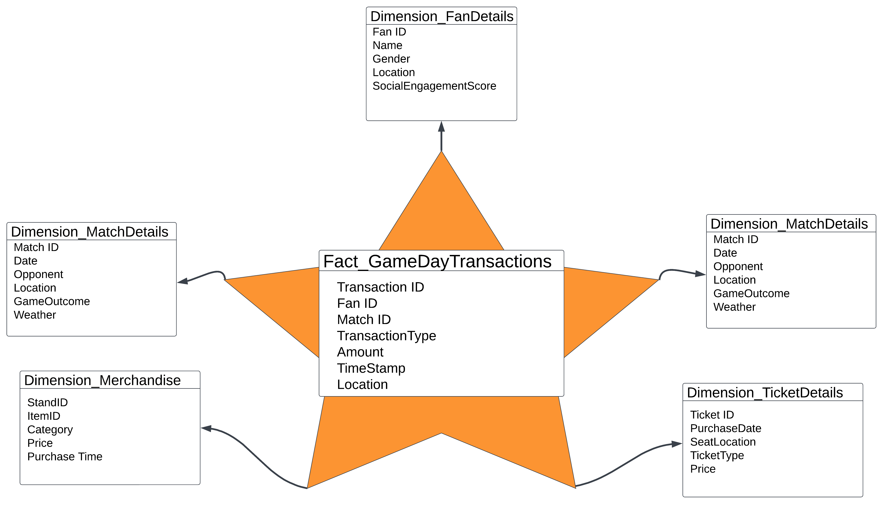

Proposed Model

Slide 10
Personalized Fan Engagement - Sarah’s Game-Day Experience
Ticket Sales & Attendance Patterns
Concession Purchases & App Data
Social Media Engagement
Wi-Fi & Fan Movement
Operational Efficiency
Notes:
How This Data Structure Enhances the Game-Day Experience
Concrete Example: Personalized Fan Engagement
Let’s imagine Sarah, a season ticket holder, attends Toronto FC games regularly. She usually sits in section 105 and often purchases snacks at halftime using the stadium app. The data model can leverage her past interactions to enhance her future game-day experience.
Ticket Sales and Attendance Patterns: The fact table stores Sarah's season ticket information, tracking her attendance and seat preferences. Using this data, the model identifies that she prefers seats near the midfield and attends most home games. This can prompt the team to send her personalized offers for premium seats in her favorite section for high-profile matches.
Concession Purchases and App Data: Sarah frequently uses the stadium app to order food. The concession dimension shows that she orders nachos and a drink during halftime at every match. Based on this information, the app sends Sarah a pre-match offer for a discount on her usual order if she places it before the first half ends, reducing wait times at concession stands.
Social Media Engagement: Sarah is also active on Twitter, regularly posting about Toronto FC matches. The social media dimension tracks her positive engagement, and the marketing team notices she interacts frequently with posts about her favorite player, “Player X.” In response, the team sends Sarah a personalized notification during the next game, offering her a discount on a jersey for “Player X.”
Wi-Fi and Fan Movement: Based on Sarah’s Wi-Fi usage patterns, the model identifies that she frequently visits the fan zone at the west end of the stadium during halftime. Knowing this, the team could push promotions for activities or merchandise available in that area to enhance her in-stadium experience.
Operational Efficiency Example:
The match dimension includes historical data on weather conditions and fan attendance. If a rainy day is forecasted for the next game, the stadium management can adjust staffing levels at indoor concession stands based on insights from previous rainy matches. Similarly, they can promote indoor seating areas and provide fans with discounts on hot beverages, increasing comfort and sales during poor weather conditions.

Slide 11
Why These Choices Are Appropriate
Personalized Engagement
Operational Efficiency
Revenue Growth
Notes:
Personalized Engagement: The use of a star schema allows the team to pull personalized insights for fans like Sarah, driving increased loyalty and satisfaction by offering tailored promotions and services.
Operational Efficiency: By analyzing data on concession sales, fan movement, and weather conditions, the team can optimize stadium operations, reduce congestion, and improve the overall fan experience.
Revenue Growth: Leveraging data from multiple dimensions—such as ticket sales, merchandise purchases, and social media engagement—helps Toronto FC identify high-value fans and offer them personalized incentives, encouraging repeat attendance and increased spending.

Slide 12
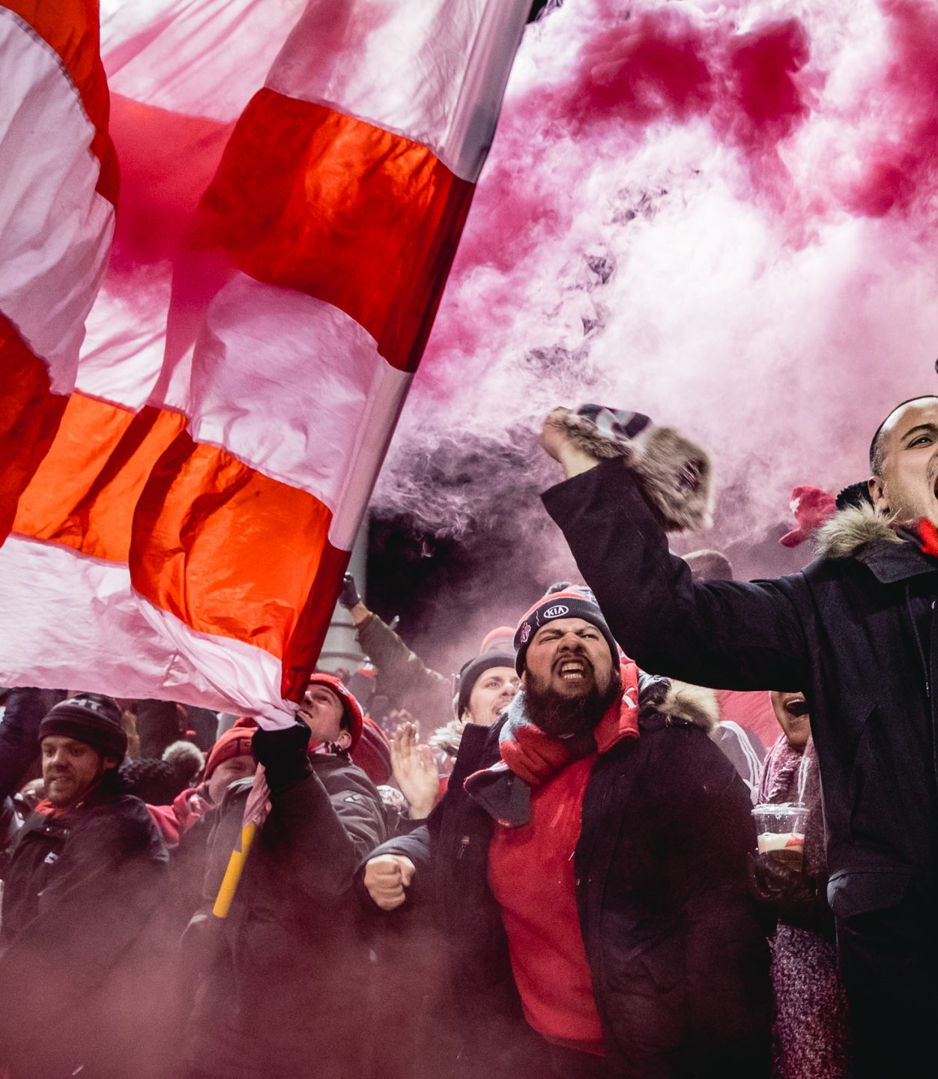
REFERENCES
MLS Official - https://www.mlssoccer.com/stats/
Toronto FC Official - https://www.torontofc.ca/
ESPN Soccer - https://www.espn.com/soccer/
Footystats - https://footystats.org/
FBref - https://fbref.com/en/
Data Model - https://www.erwin.com/learn/data-model.aspx

Slide 13

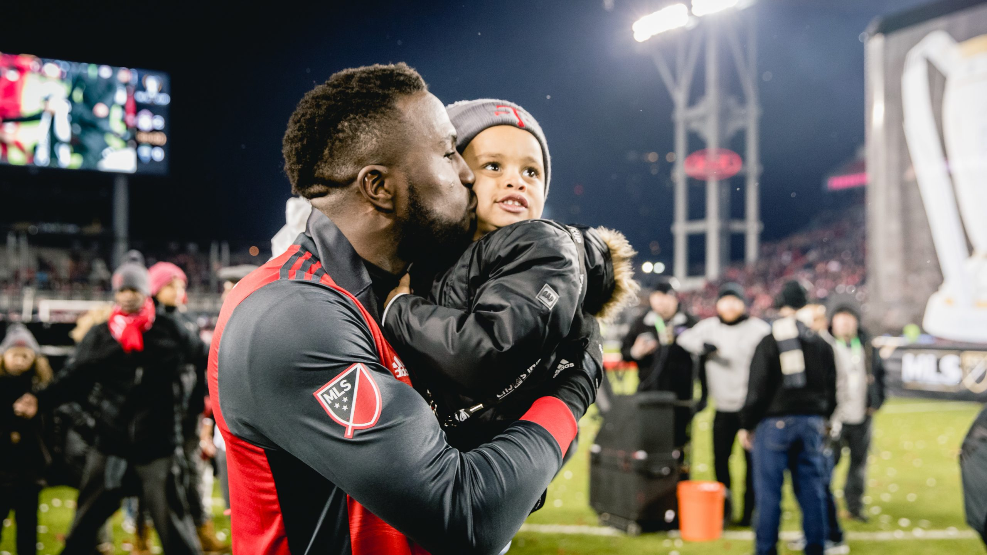
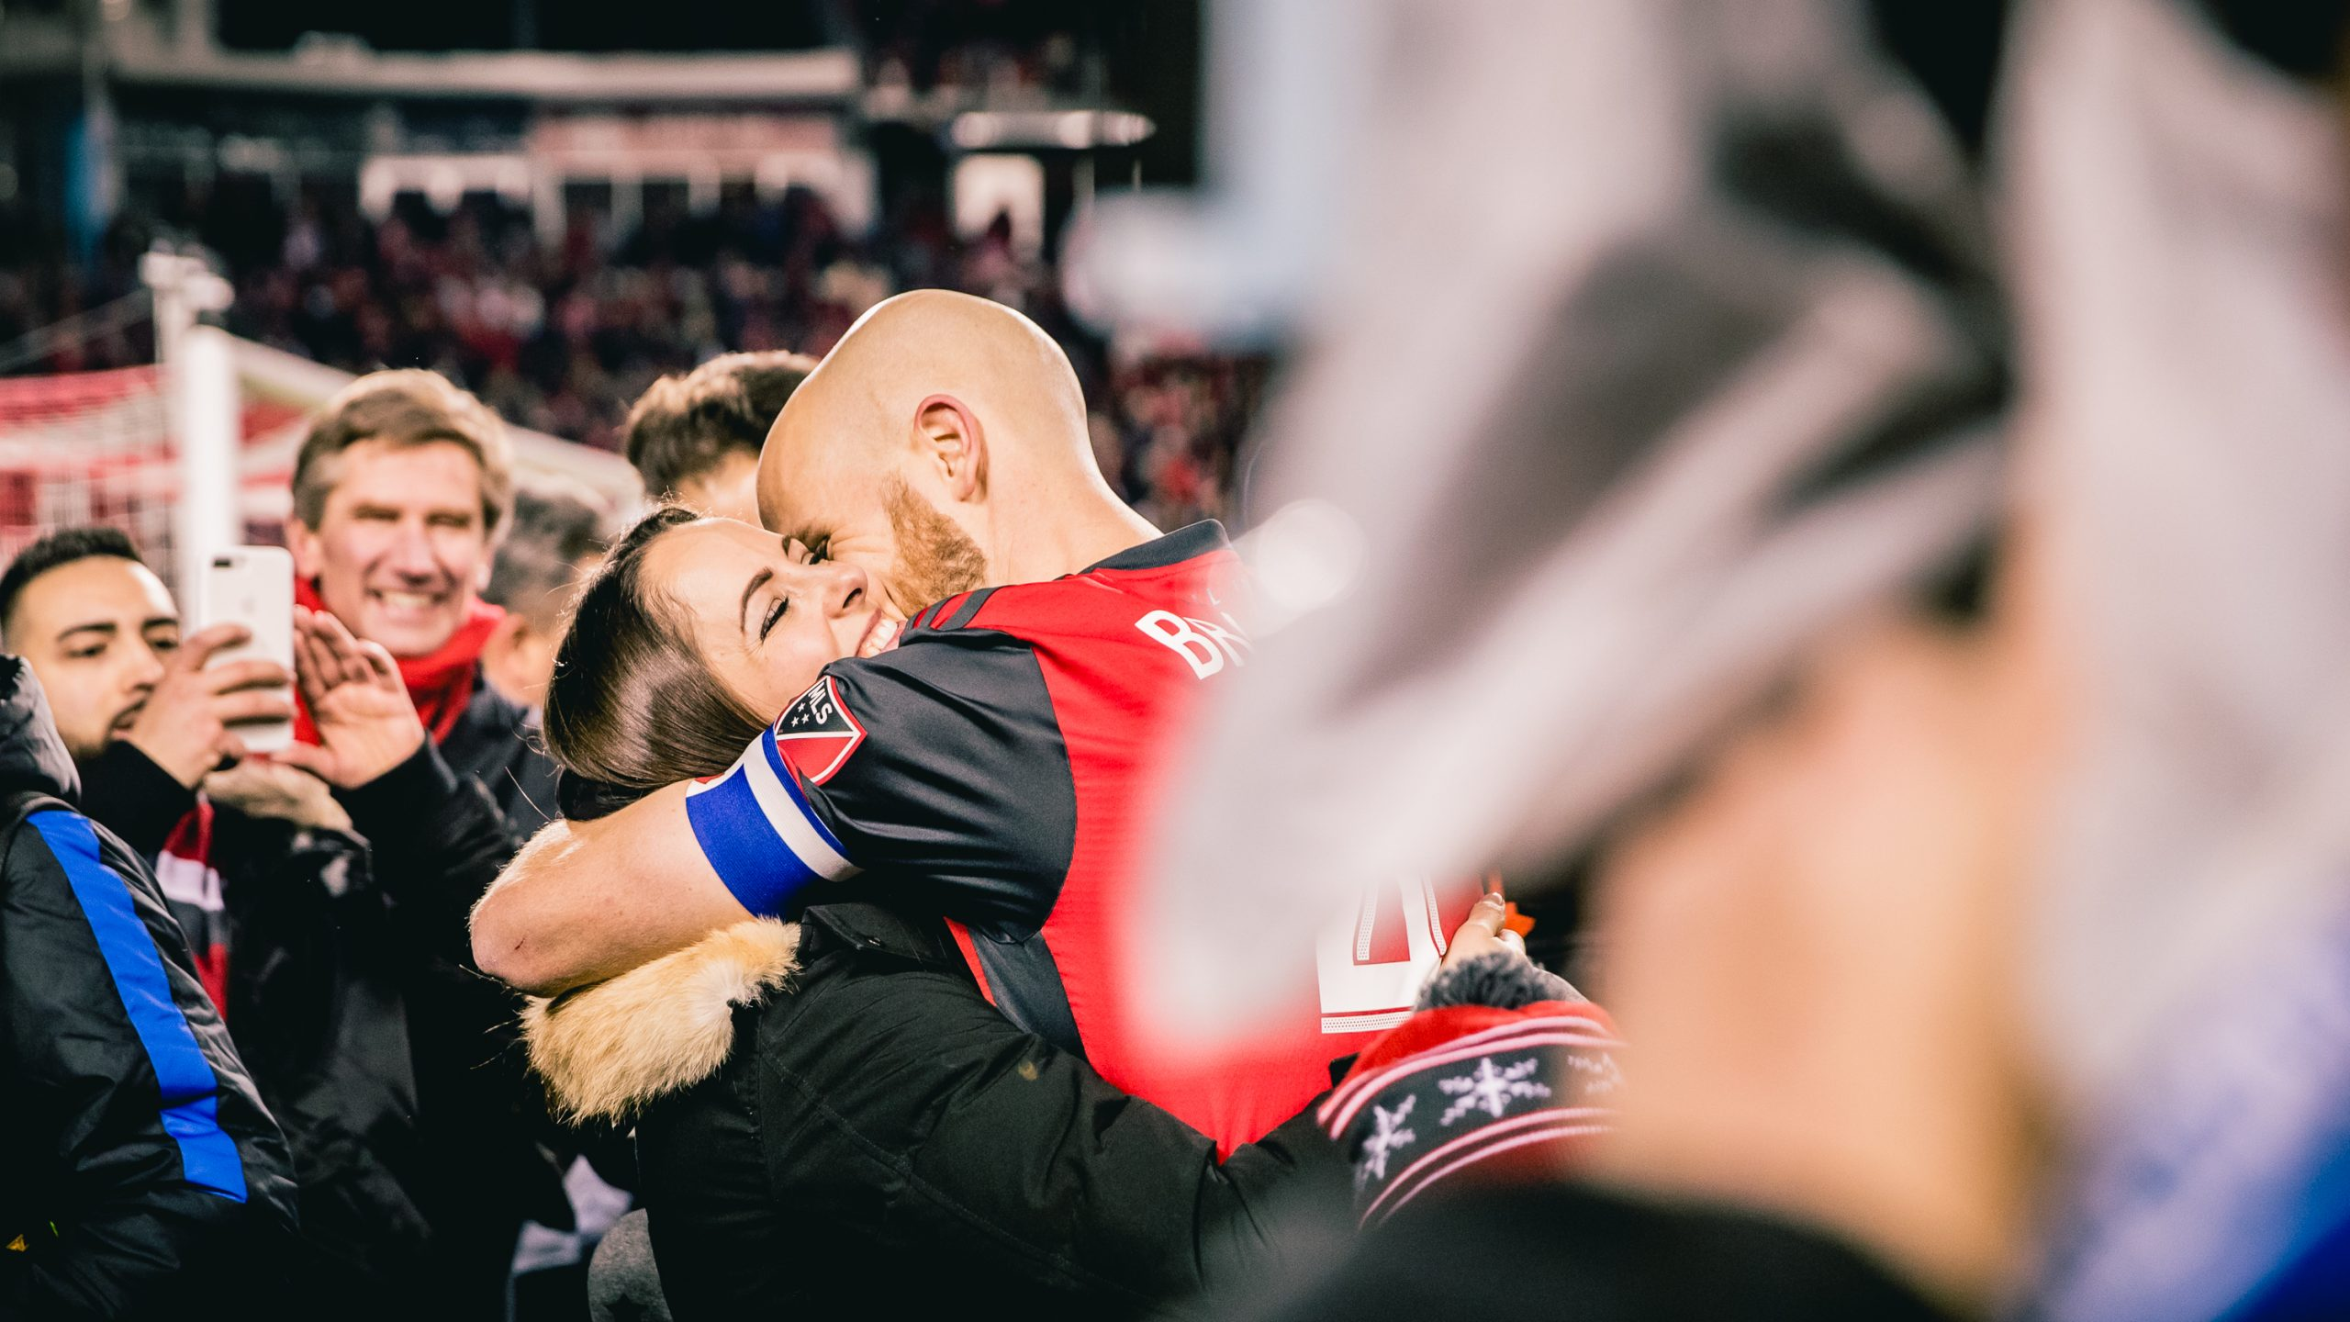
THANK YOU

